Slide 1
JOURNEY PPT Technical Onboarding - Week 5 Custom IDA Bootcamp
Afrin Siddiqui – IDA
Supervisory Organization: PTIY/FBD CC HR and Corporate (Pankaj Janak Kumar) (59726509)
Position Title: 54077724 Associate Data Engineer
Location: Bangalore RMZ-ECO WORLD
Employee ID: 654991

Slide 2
Day 1 – Python Cont.
Learned about python keywords and functions.
Concept of functions (Built-in, User-defined, Single function, Time stamp function)
Implemented modules in code such as datetime,time, calender
Completed assessment of Azure Synapse and PowerBI.

Slide 3
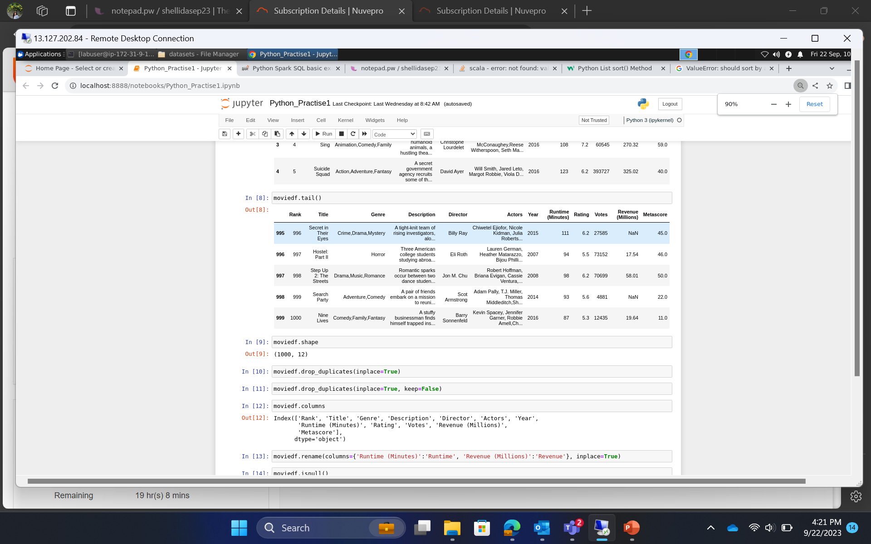
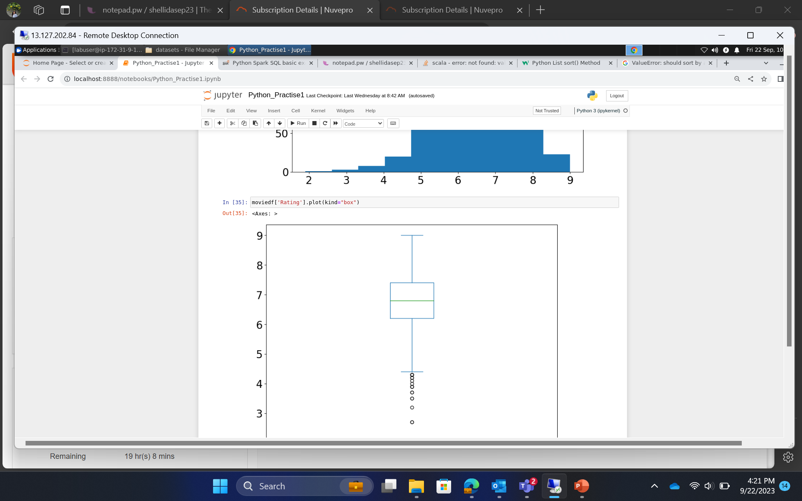
Day 1– Hands on training/ Practical Work

Slide 4
Day 2 – Pandas in Python
Pandas Daframe is two-diemsional2, size mutable, potentially heterogenous tabular data structure with labeled axes (rows and columns).
Learned how to create a dataframe and to perform operations on it such row and column selection., indexing and selecting data.
Checking for null and missing values and how to deal with them using isnull() and notnull() functions.

Slide 5
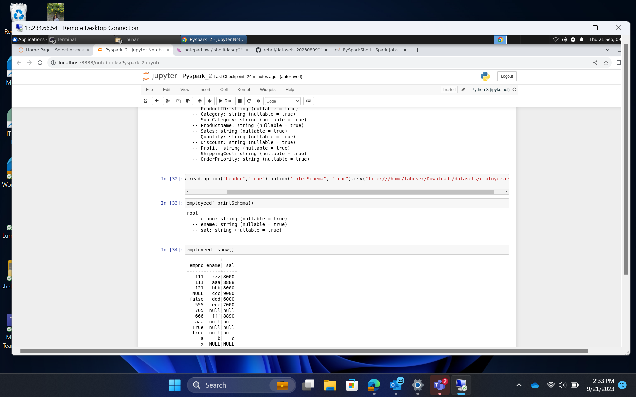
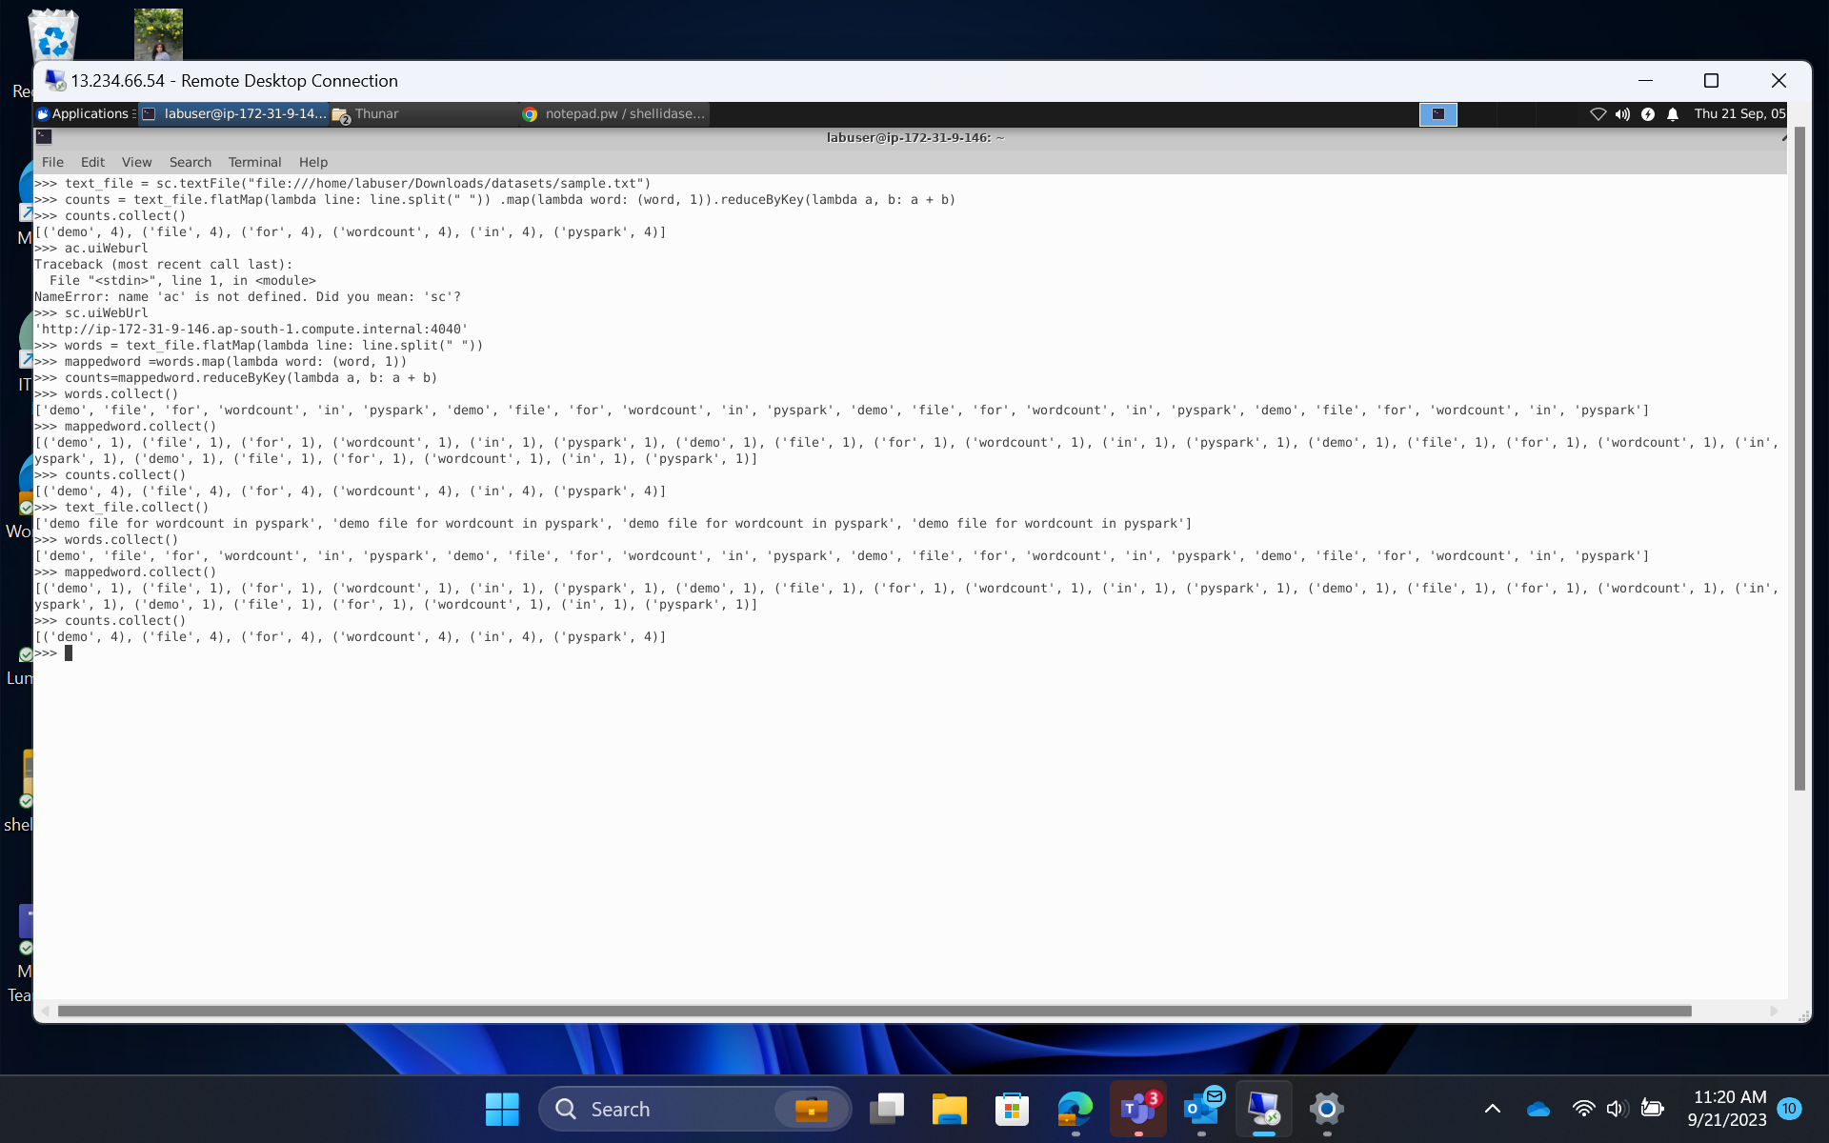
Day 2 – Hands on training/ Practical Work

Slide 6
Day 3 – Introduction to Spark
Apache Spark (Data analytical tool) and Databricks (Commercial licensed product)
Working of Spark as a unified, open source, parallel data analytics tool.
Learned about features of RDD in Spark
Reading/Ingestion of data and analysis
Concept of MPP – Massively parallel processing
Spark as a in-memory processing framework

Slide 7
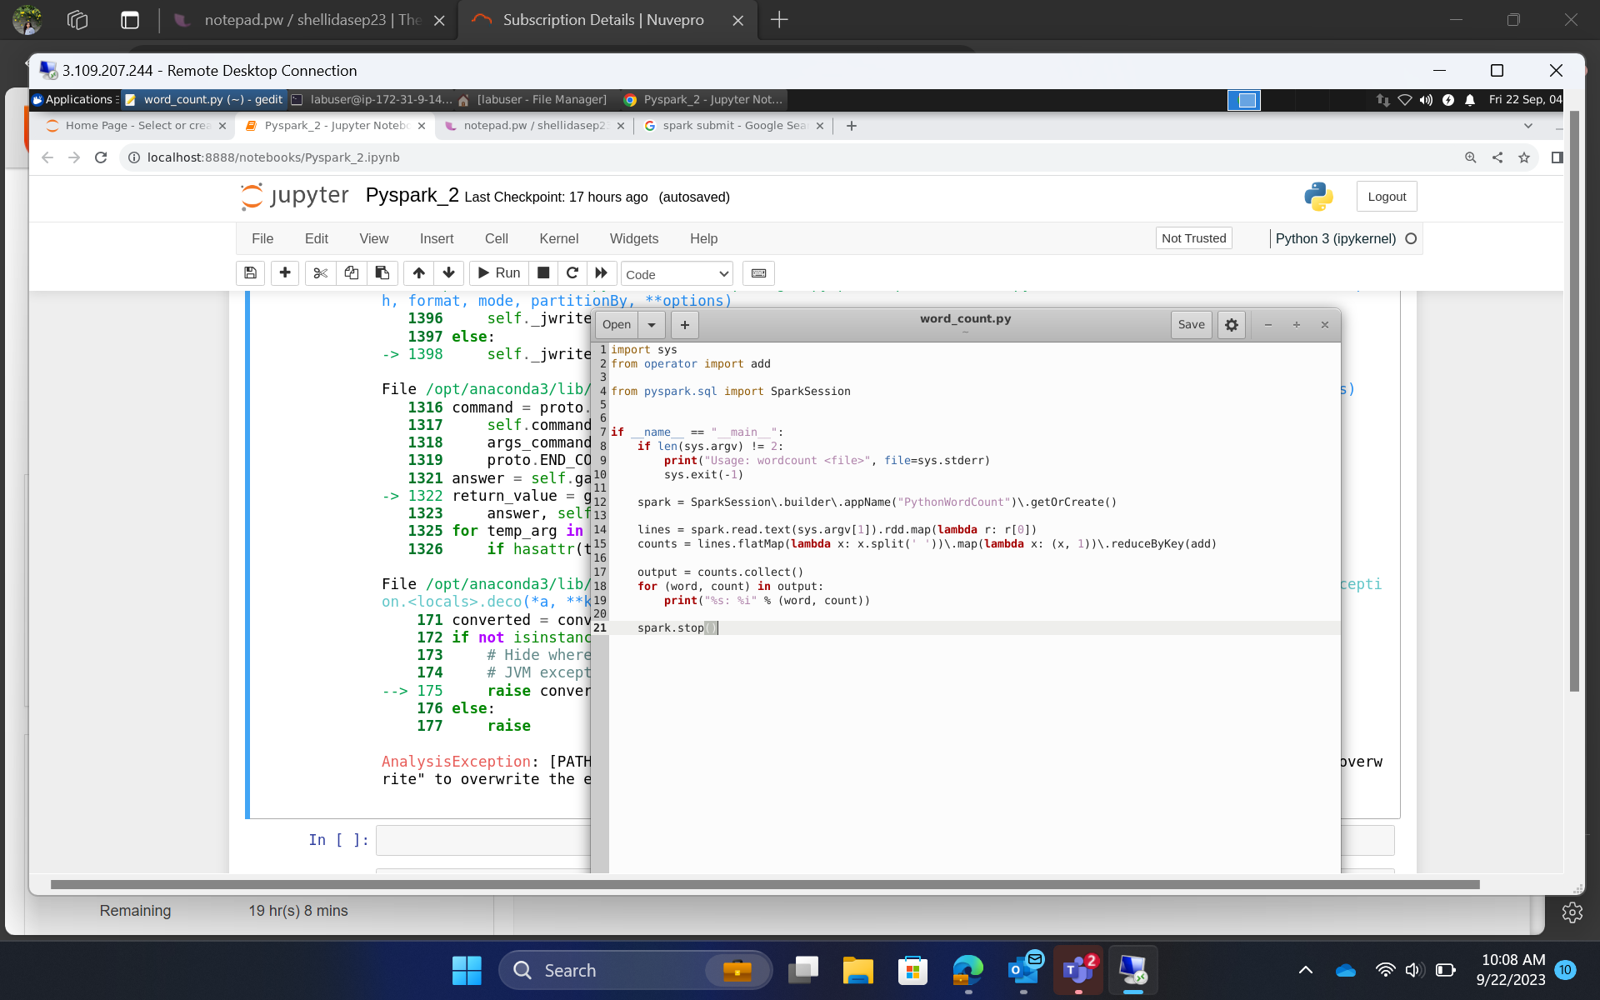
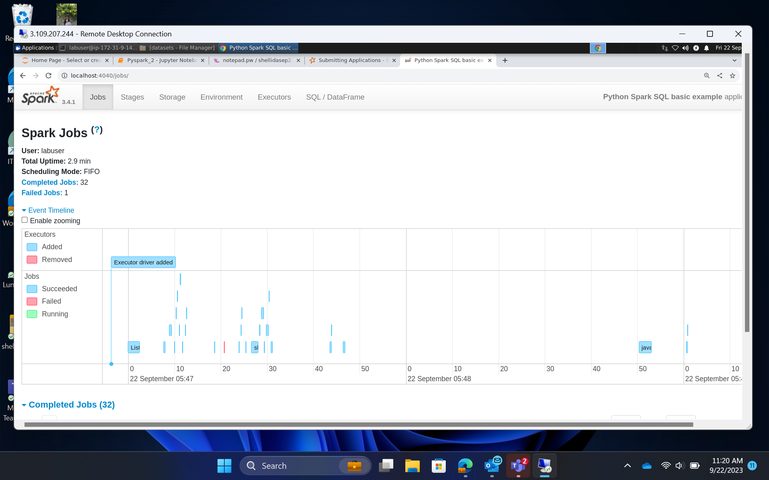
Day 3 – Hands on training/ Practical Work

Slide 8
Day 4 – Hands on training on Spark
Performed hands on practical in Spark.
Understood the concept of spark jobs, reading data onto spark from a python file, performing analysis and converting sql commands into python commands for analysis.
Concept of repartition and coalesce was also explained in detail.

Slide 9
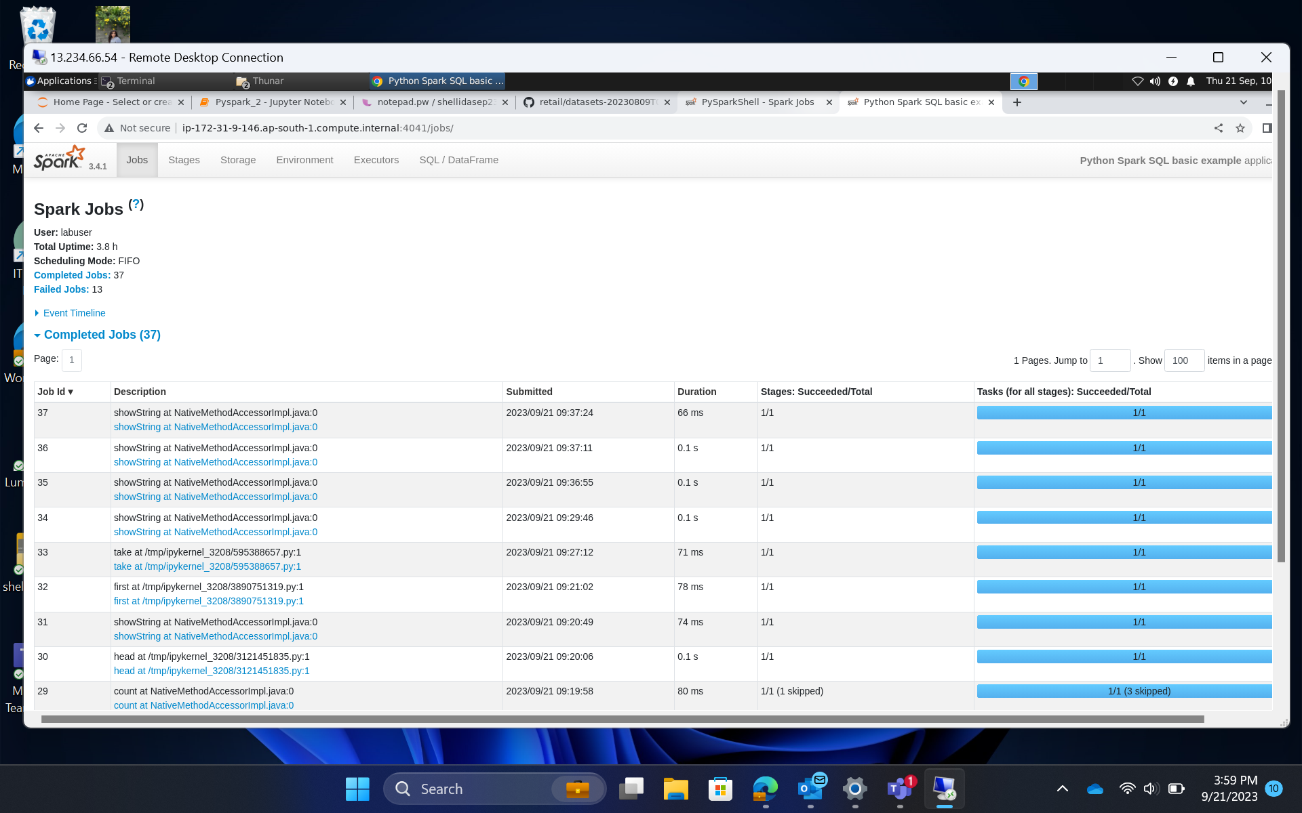
Day 4 – Hands on training/ Practical Work

Slide 10
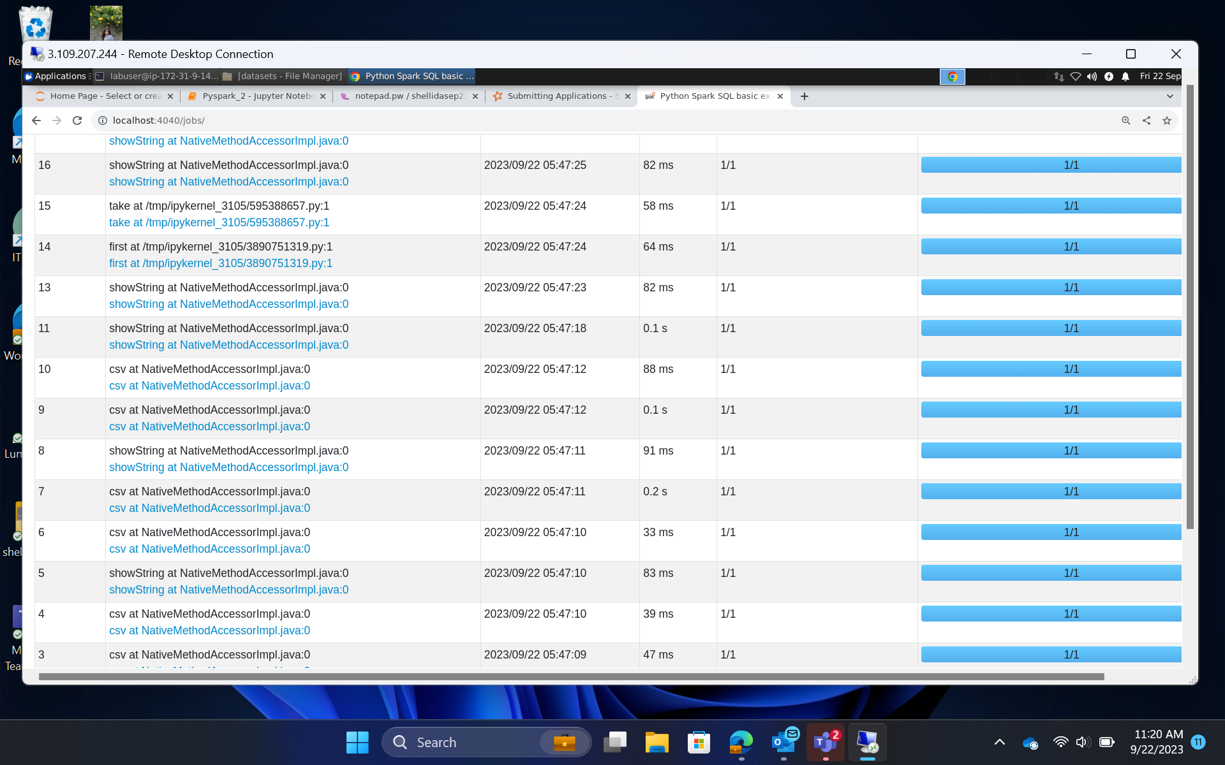
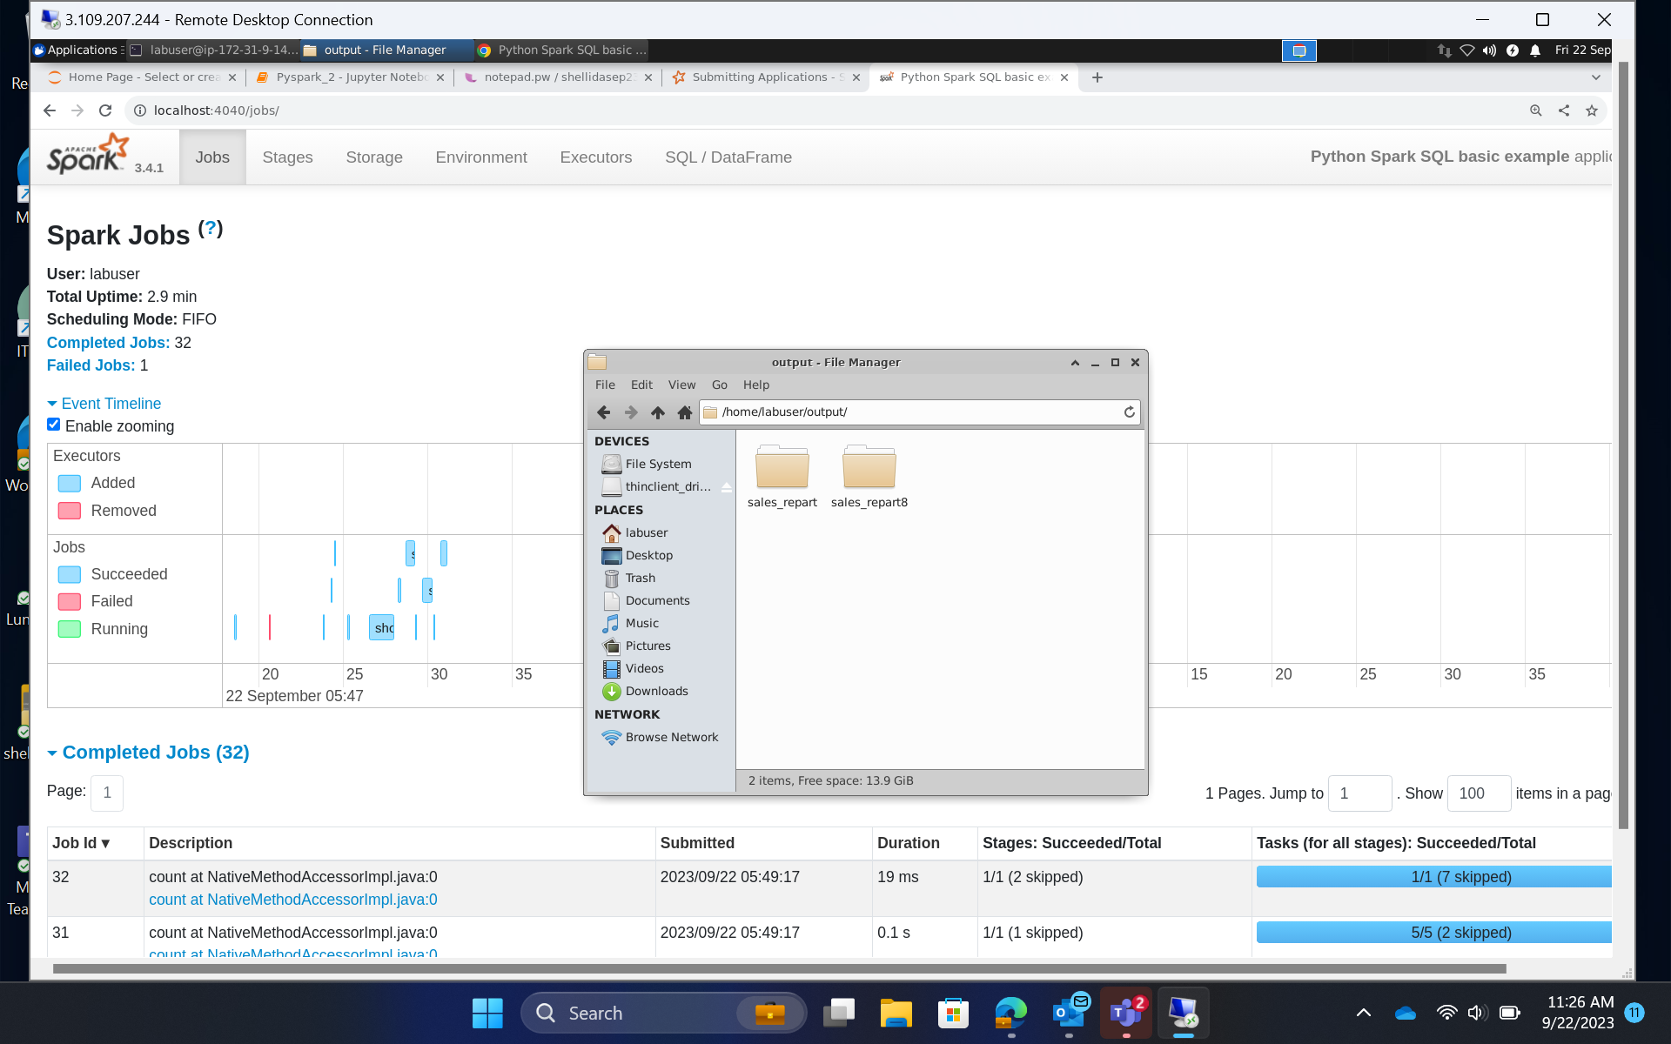
Day 4 – Hands on training/ Practical Work

Slide 11
NOTE
There was no bootcamp training on 18th September, 2023 (Monday) as it was a holiday.

Slide 12


